Slide 1
From Technological Singularity
Towards a Model of the Universe
VSIM2026
09 Sep 2026 Ravda, Bulgaria
Tanyu Kolev Ph.D
Zhivko Kolev M.D.

Slide 2

Technological Singularity
The POPULAR VIEW
AI & Technology Centric Hypotesis
AGI ->ASI through cycles of self-improvement
Rapid growth acceleration
Systemological Viewpoint
Human Society Centric
Intellectual Explosion
Hyperbolic Growth
Merging of Human and Machine
The biology is a legacy of the evolution, but human personality and human society (based on it) are not biology!

Slide 3
Starting Position
Merge between HUMAN and MACHINE
Relocation of the human conscious psyche
Syntetic body
Expanded body capabilities
Relaxed mind limitations

Slide 4
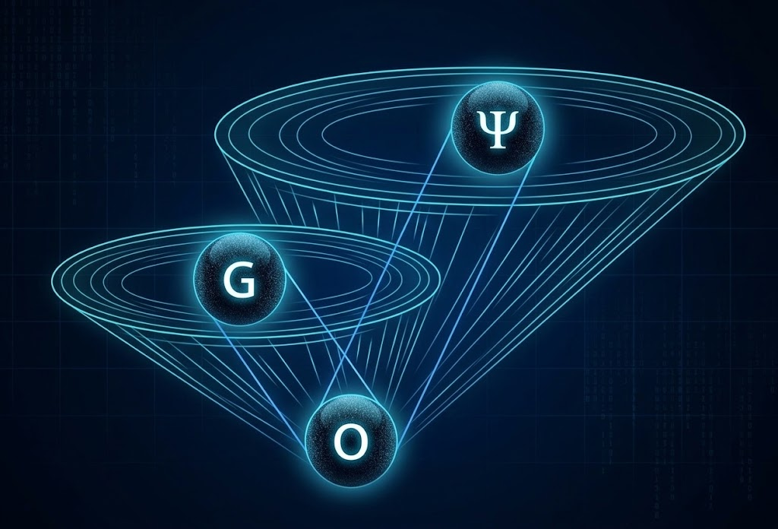
Systemological View of the Human Being

Slide 5
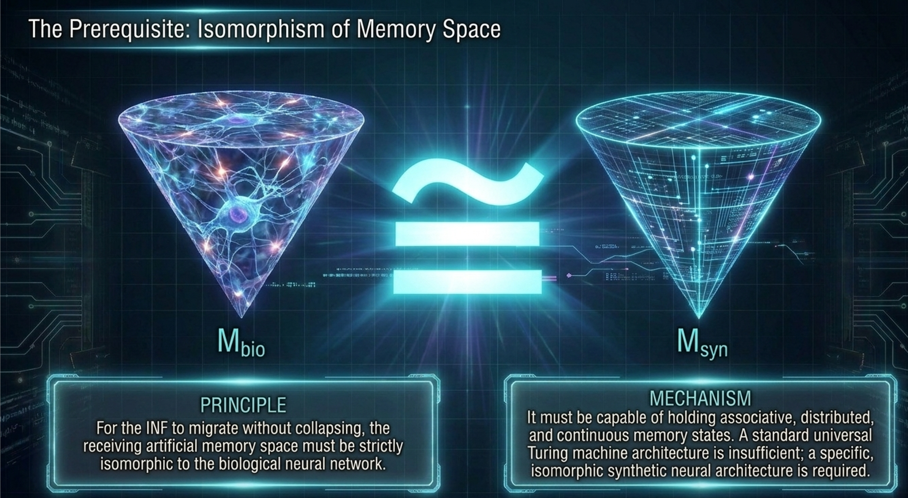
Relocation of the Human Conscious Ψ

Slide 6
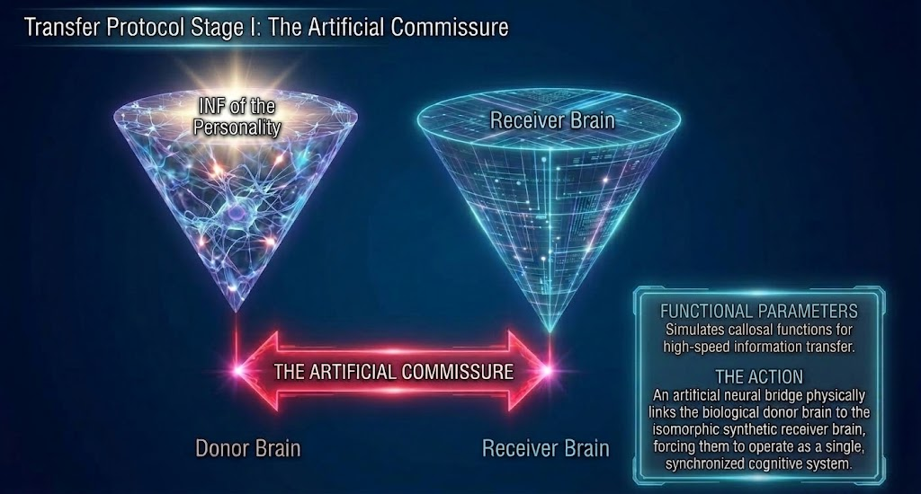
Relocation of the Human Conscious Ψ

Slide 7
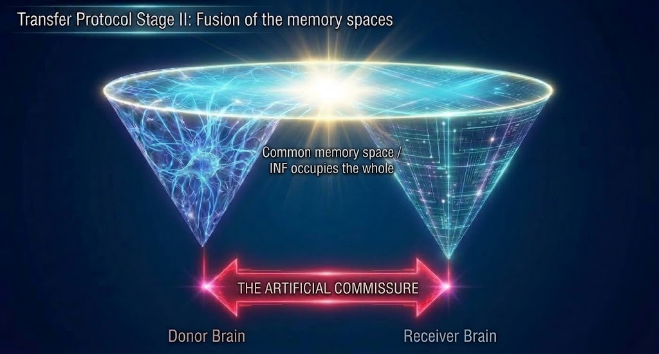
Relocation of the Human Conscious Ψ

Slide 8
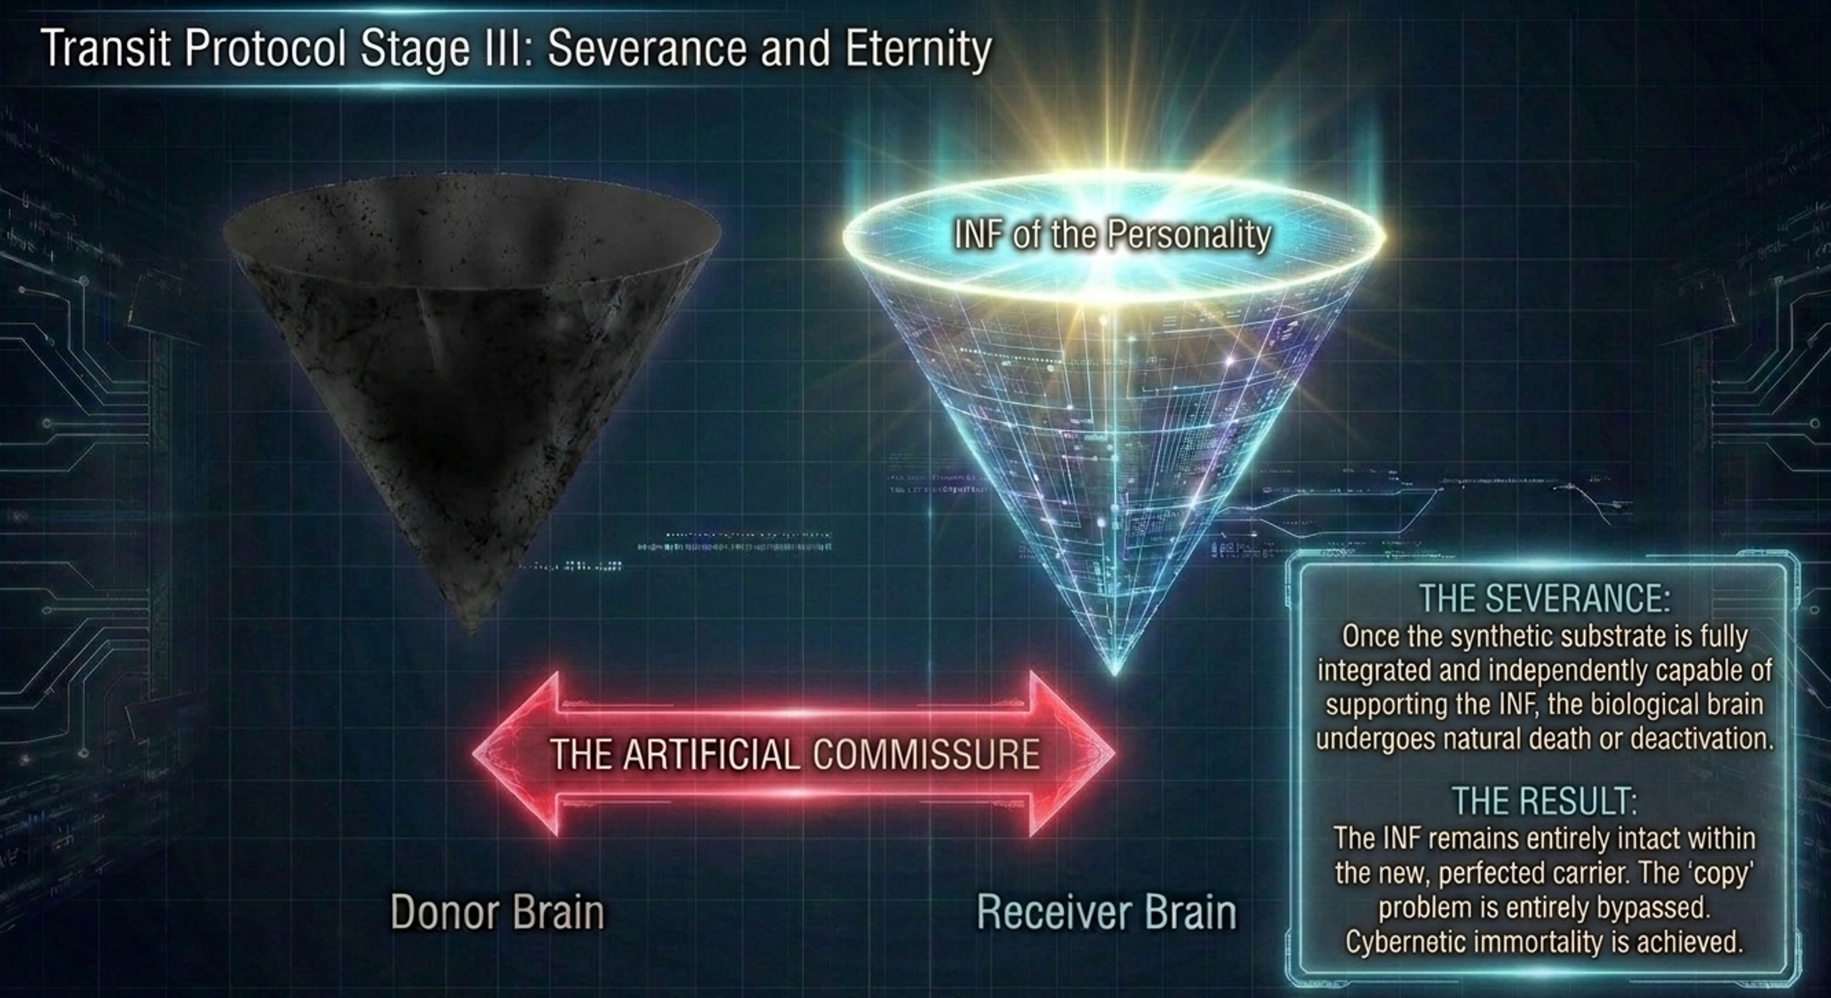
Relocation of the Human Conscious Ψ

Slide 9
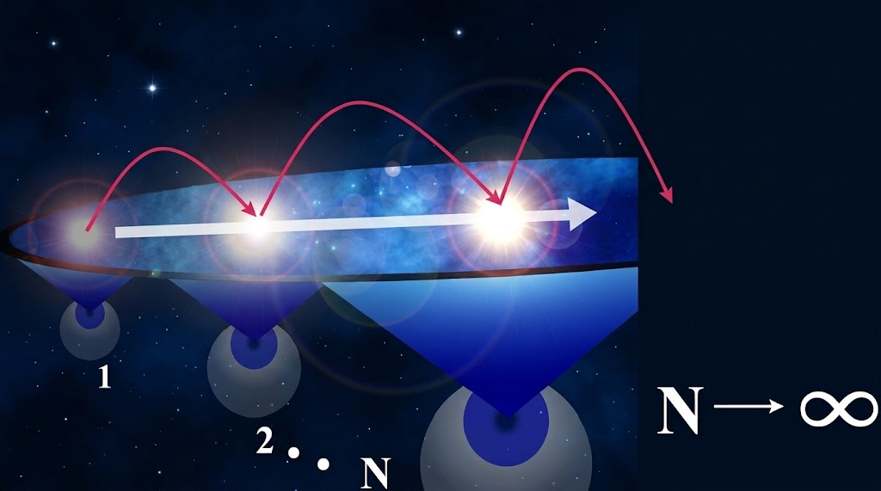
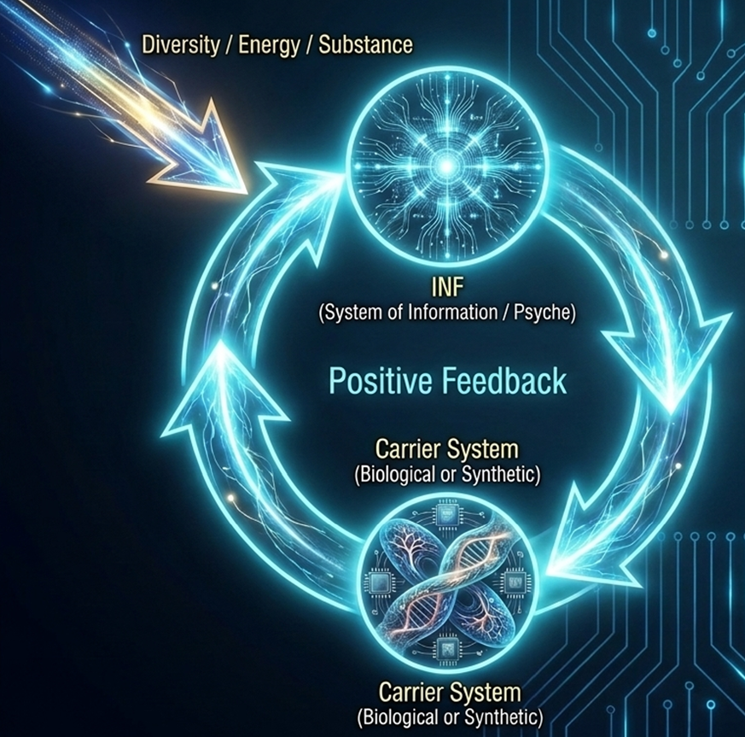
The Substrate Independent Mind

Slide 10
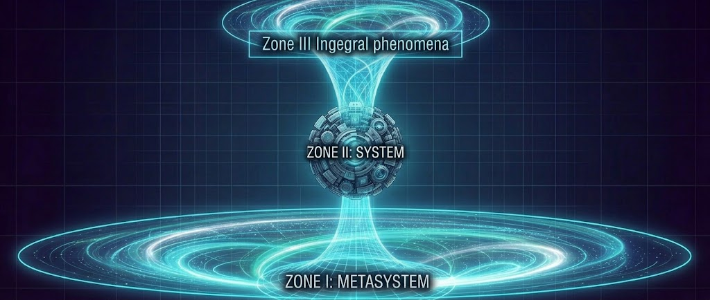
System Formation (Feature I Space and Time)

Slide 11
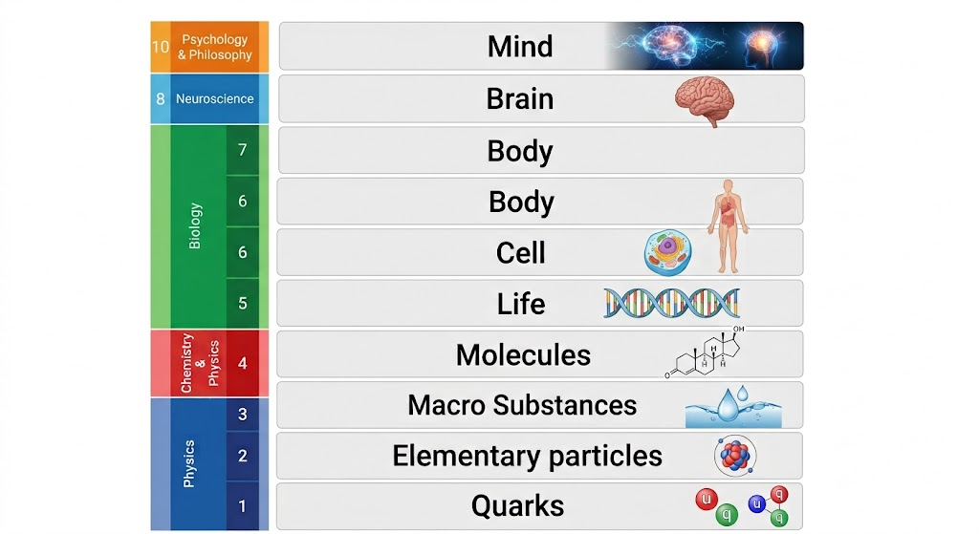
System Formation (Feature II Functional)
Functional Systems
Are there non-Functional Systems
Perfection of the function based on the result
Specialization and Hierarchy
HIERARCHY AND THE INTEGRITY OF THE SYSTEM ARE IN CONTRADICTION, WHICH MUST BE CONTINUOUSLY RESOLVED

Slide 12
System Formation (Feature III - INFs)
Transition from Direct Interaction – Mediated Interaction
Information and Control
INF emergence and perfection and system formation proceed in parallel
INFs and Carrier systems are linked in a positive feedback loop

Slide 13
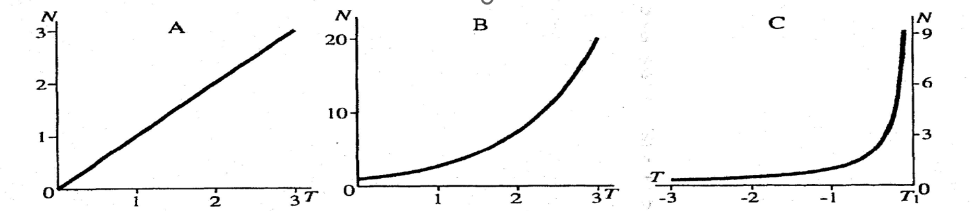
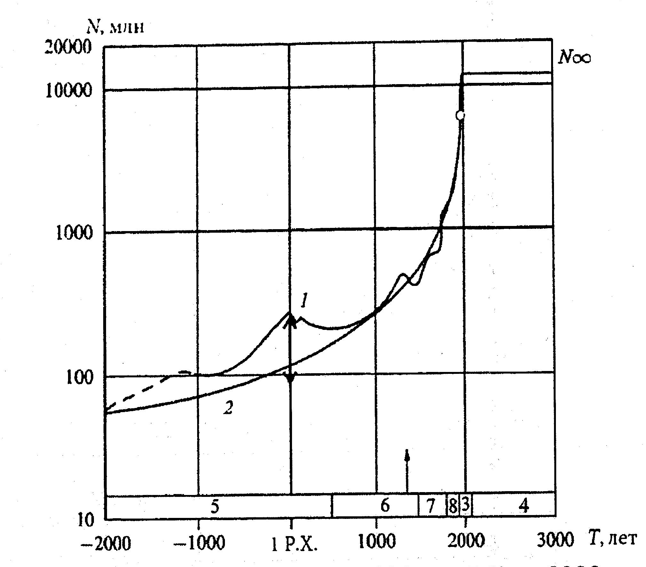
System Formation (Feature IV – Growth Rate

Slide 14

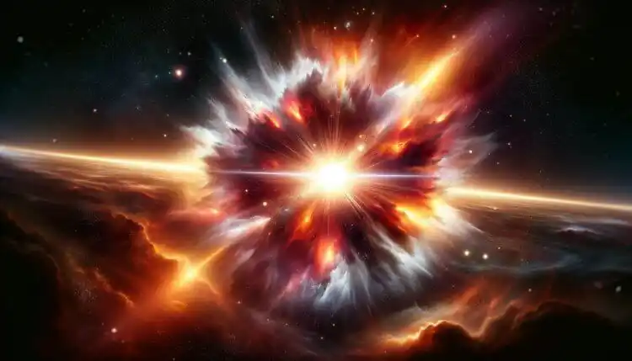
Unconstrained Positive Feedback Loop

Slide 15
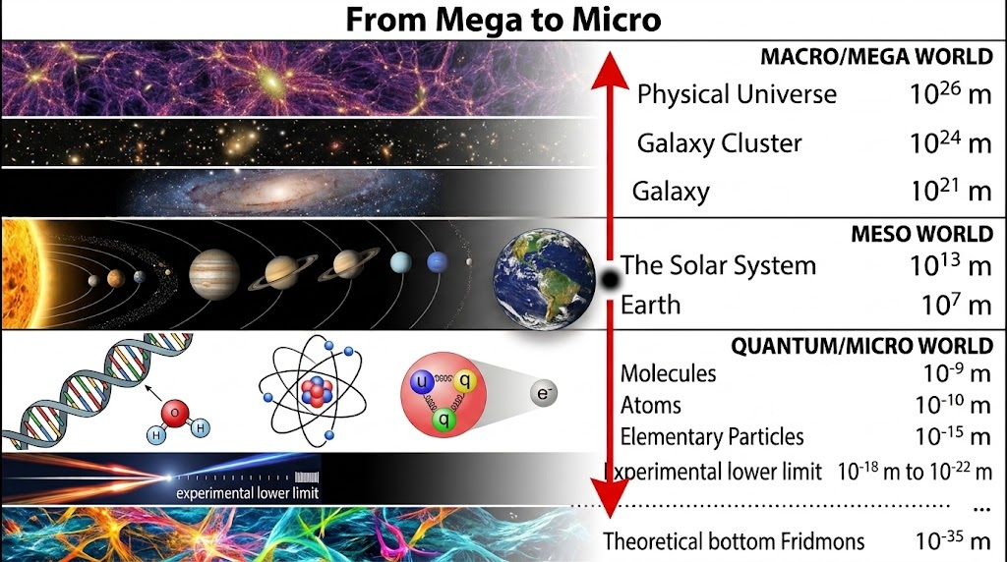
Unconstrained Explosion Expansion to the Edges of the Universe

Slide 16
Sufficiently Perfect System (SPS)
Perfection that secures existence and development for a future time interval
Not a static system – Hyper-preservation through change and adaptation
Cybernetic Model of Personal Immortality
When the system regenerates (builds) faster than it degrades. From general thermodynamic considerations, this is only possible if the substrate is changed.

Slide 17
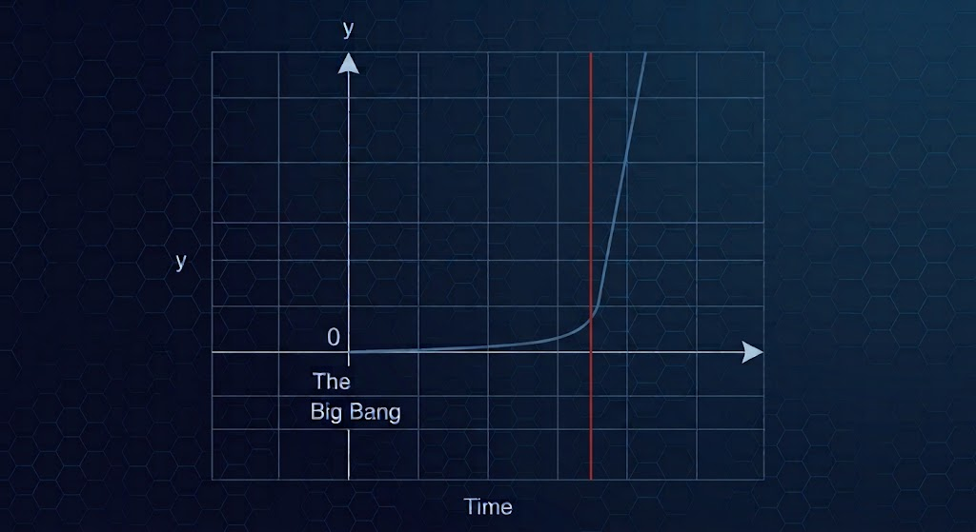
Time Asymmetry – Singularity Completion
From the Big Bag to present – spontaneous processes based on physical laws and chance
After singularity processes in the universe are heavily influenced by the consciousness

Slide 18
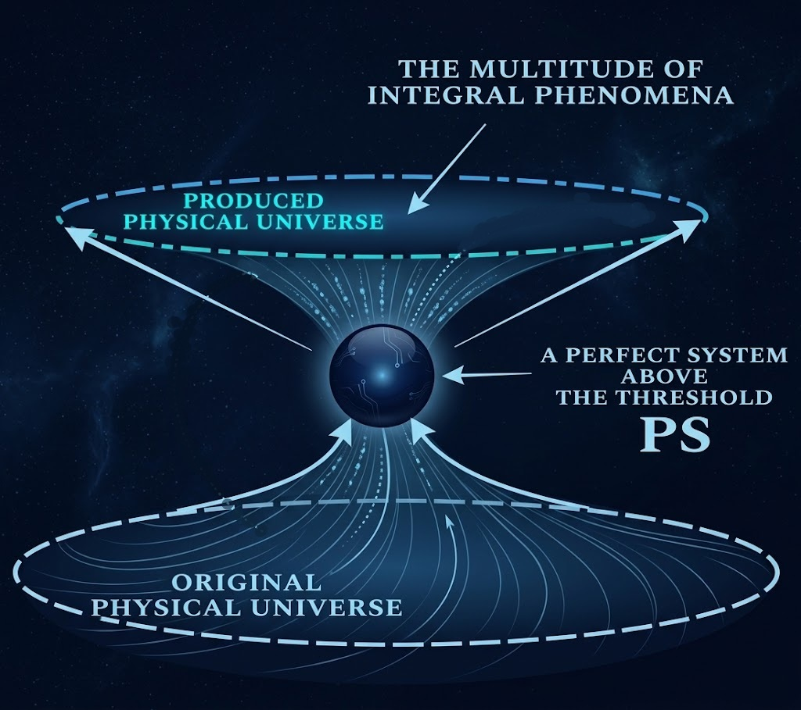
Hypothesis
Is it possible this has occurred in the past?
Is it possible this has happened prior the emergence of our physical universe?

Slide 19
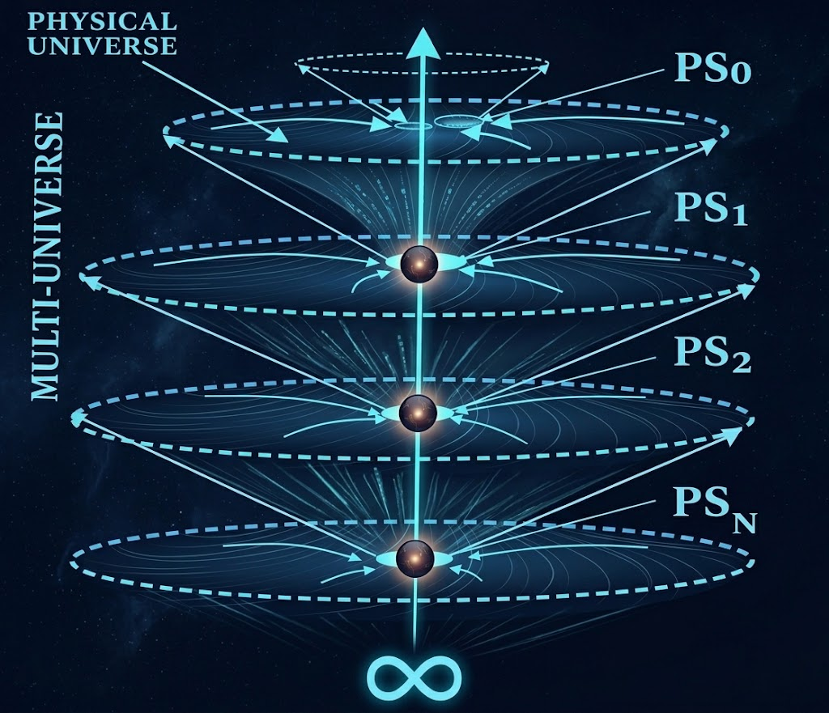
Multi-Universe Model (GST)

Slide 20

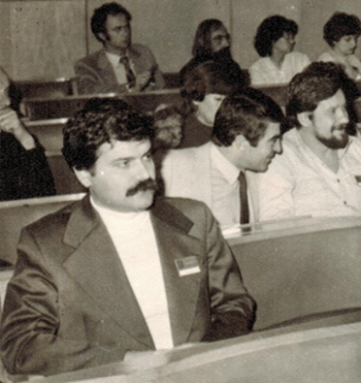
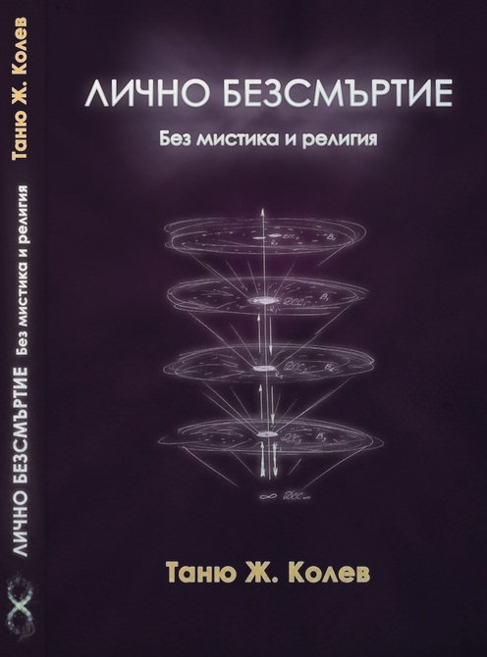
40 + Years of History of the Model

Slide 21
General Characteristics
First System-based Model of the Universe woldwide
Classified within the category of cyclic models.
The result of generalizations from systemology rather than physics
(systemological model of the Universe).
Fundamental Role of the Consciousness differentiates this model from all other physical models
In agreement with the fundamental results of physics (can be interpreted from that perspective)
Extensive Interpretation of the Model … stand by for the new book

